Slide 1
smartTrade: Liquidity Connect 6.0.x.x Concepts and API overview

Slide 2
Concept – connecting heterogeneous worlds
Liquidity Connect
External Connector
<T1>
Translator
<T1, T2>
External Connector
<T2>
message
type = T1
message
type = T2
World 1
World 2
Connectors
<T1>
filter
router
replier …
Connectors
<T2>
filter
router
replier …
Translator
<T2, T1>
Liquidity Connect = Bridge(s) between worlds
Notes:
2

Slide 3
A Framework
Liquidity Connect is a Framework
Defines a set of patterns, to be implemented & assembled
Each element implementation can be shared and re-used by different bridges
Special features : Throttling, Monitoring, JMX
If connected to STTP, relies on STConnect API : leverages partitioning & load balancing

Slide 4
LiquidityConnect is not STConnect
STConnect is used to connect to STTP.
It can be embedded in a 3rd party application
It initiates the connection to a STTP server.
LiquidityConnect is used to be a bridge to a 3rd party system
It initiates the connection to the 3rd party systems
The 3rd party system can be STTP (in this case, it is based on STConnect)

Slide 5
A SmartContainer
Liquidity Connect is defined in a SmartContainer
Easy assembly, via Spring
LifeCycleManger allows to control the startup sequence of any beans
Bridge Readiness: All the elements in the chain have a state, that they forward, to know when the whole chain is ready.
Replication and Failover as any bean can replicate its data to a backup, if necessary, to support a hot failover

Slide 6
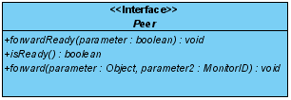
Peer concept
Peer pattern
Each element is the Peer of another element, and receive a message from it.
Each Peerable element has a peer to forward a message to.
Composite design pattern: a complex element (containing several Peers) can be itself seen as a Peer

Slide 7
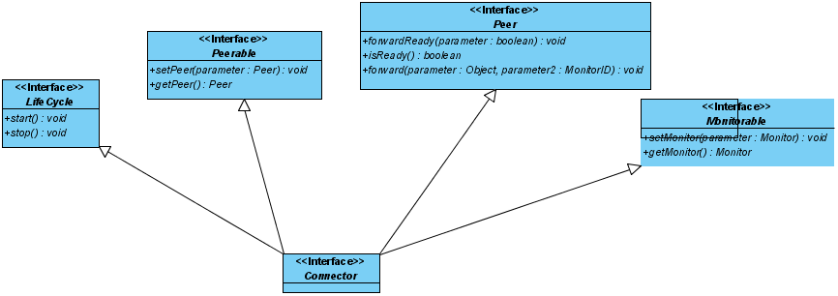
Foundations
Connector<T> is the basic block
It binds various interfaces

Slide 8
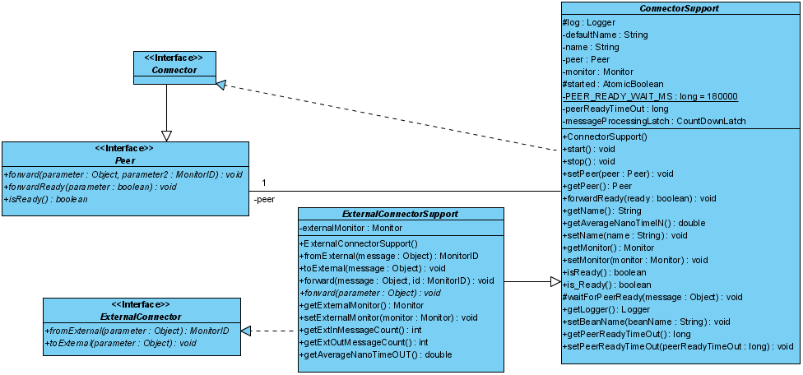
Simple peers
ConnectorSupport<T>
generic passthrough bridge element
Example: Filter, Statistics Calculation
ExternalConnectorSupport<T1, T2>
is the Peer connected to the external system. T1 is previous Peer format, T2 is external system format (usually T1=T2, as conversion is done in Translator)
Example: STTPConnector, FIX, RMDS, 29West, …
ConnectorSupport <T>
T
T
T1
External ConnectorSupport <T1, T2>
T2
Ext
T1

Slide 9
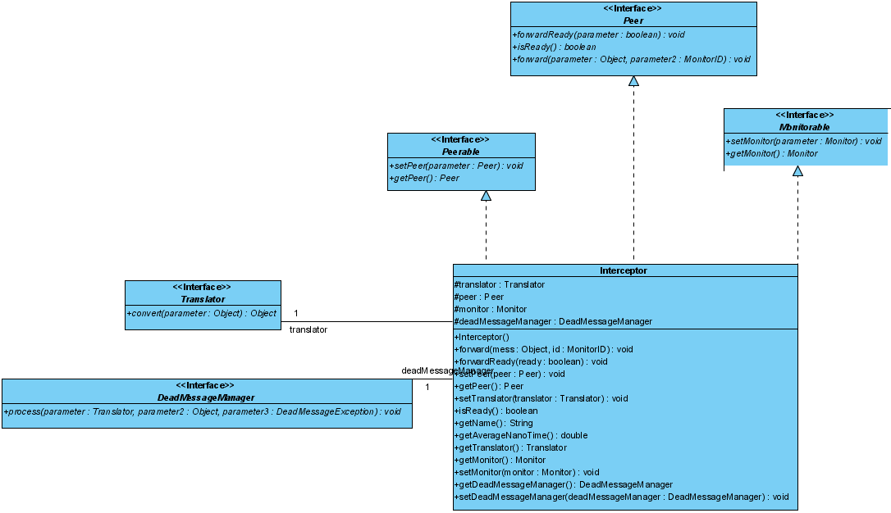
Simple peers (cont)
Interceptor<T1, T2>
Embeds a Translator<T1,T2>
data mapping: converts T1 message in T2 format
Example: STTP2FIXNewOrderSingleTranslator…
Not defined in Spring configuration
Translator <T1, T2>
T1
T2

Slide 10
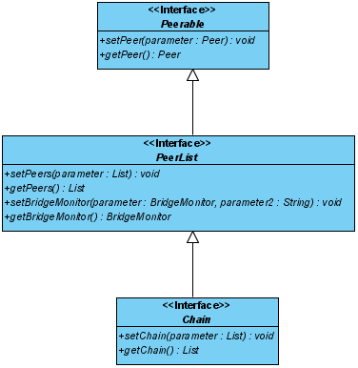
Complex peers
Bridge (Chain)
A linked list of Peers, considered as a Peer itself
Any LiquidityConnect application has at least one Bridge
Bridge
T
Peer
Peer
T
Peer of Bridge

Slide 11
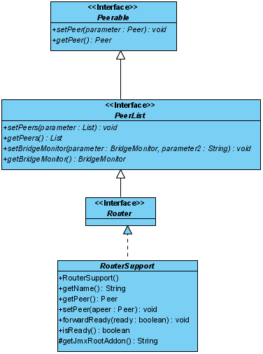
Complex peers (cont.)
RouterSupport<T> (Router<T>)
message routing: can route to other components, based on a key
Example: MessageTypeRouter
RouterSupport <T>
T
route1
T
T
xor
Peer of Router
T
route2
T

Slide 12
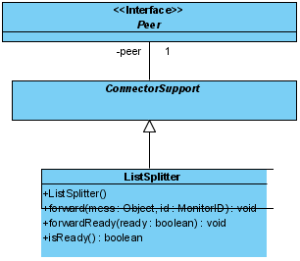
Complex peers
ListSplitter<T>
T MUST be a collection. The splitter forwards each item of the collection to the next Peer
Usually used as Peer of a Translator<T1, T2>, where T2 is a collection
ListSplitter <T>
<T> = [T items]
T item1
T
then T item2
then T item3…

Slide 13
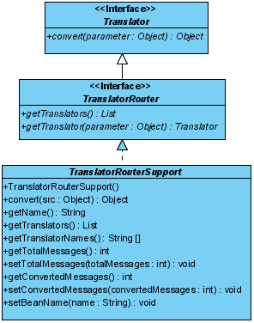
More complex peers
TranslatorRouterSupport<T1, T2>
Built-in, a mixed of Translators and Router
Route a message T to the adequate Translator<T1, T2>
Ex: STTP2FixTranslatorRouter, Fix2STTPTranslatorRouter
T
TranslatorRouterSupport <T1, T2>
(T11)T1
Translator
<T11, T22>
T22 as T2
Peer
<T1>
T1
ClassCast
polymorphism
Peer<T2> of TranslatorRouterSupport
(T111)T1
Translator
<T111, T222>
T222 as T2

Slide 14
Very… complex peers
Everything is possible!
Re-usable configurations

Slide 15
Sample Configuration
You simply declare your peers linkage
<bean name="fixSTTPBridge" class="com.smarttrade.smartconnect.Bridge">
<property name="chain">
<list>
<ref bean="messageTypeRouter" /> <!-- ST leg -->
<ref bean="notReadyMessageRejecter" />
<ref bean="sttp2FixTranslatorRouter" />
<ref bean="messageType2SessionTranslator" />
<ref bean="quoteRequestFilterBySymbol" />
<ref bean="fixInitiator" /> <!-- EXTernal leg -->
<ref bean="fix2STTPTranslatorRouter" />
<ref bean="marketDataThrottler" />
<ref bean="messageTypeRouter" /> <!-- ST leg -->
</list>
</property>
</bean>
<bean name="messageTypeRouter" class="com.smarttrade.smartconnect.sttp.MessageTypeRouter">
<property name="peersMap">
<map>
<entry key="ExecutionReport" value-ref="sttpSOR" />
<entry key="MarketDataSnapshot" value-ref="sttpAggregator" />
<entry key="MarketDataReport" value-ref="sttpAggregator" />
</map>
</property>
</bean>
<bean name="sttpAggregator" class="com.smarttrade.smartconnect.sttp.STTPConnector">
<property name="config" ref="aggregator.config" />
<property name="LPLogin" value=“ext" />
<property name="cancelMarketDataOutsideBeforeStop" value="true" />
</bean>
…

